Slide 1
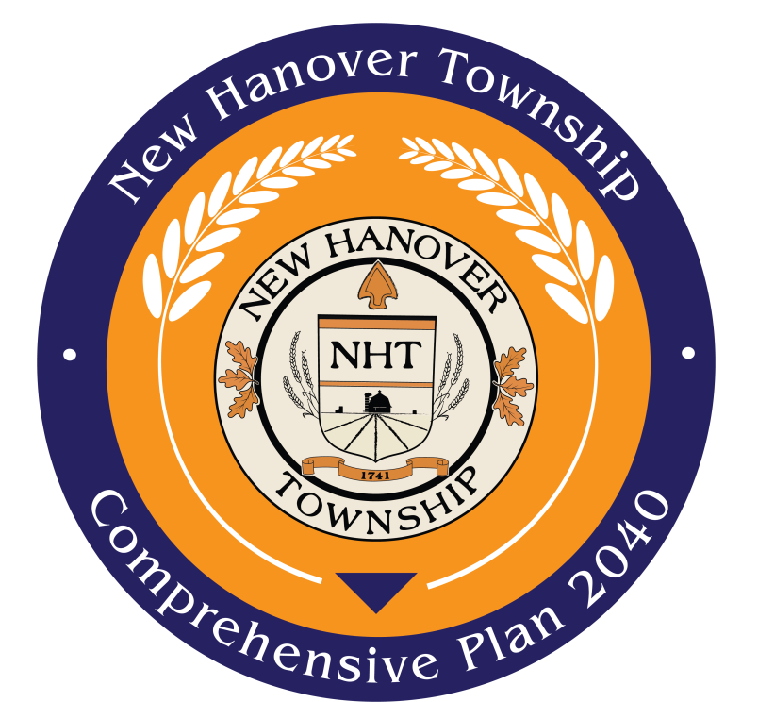

Community Workshop
New Hanover Township Comprehensive Plan
November 13, 2019
Maggie Dobbs, AICP, Senior Planner, MCPC

Slide 2
Introductions

Slide 3
What is a Comprehensive Plan?
Guiding document for municipal management outlining goals for future growth and development.
Includes an analysis of current conditions and implementation recommendations to achieve the community’s vision for the future.
Advisory to the municipality.
Required to be revised every 10 years.
Notes:
Well thank you Greg and Christine for those word of introduction. As they said, my name is Maggie Dobbs and I am a community planner with the Montgomery County Planning commission. I work with the borough extensively on all their planning needs, and we have been focusing on writing an update to the comprehensive plan. Now you may be wondering, what exactly is a comprehensive plan? A comprehensive plan is a long-range plan designed to guide the growth and physical development of a place. These plans are required by state law and should be updated every 10 years. The last update was completed in 2007 so we’re right on time for an update. The comprehensive plan is just that – comprehensive. It looks at all of the existing land uses borough-wide, everything from where homes and businesses are, where roads and parking lots are located, and where trees and parks are. Our goal with the plan is to understand where the borough is today, and where we want it to be in 20 years, which is why we’re looking out to the year 2040. Out of these conversations we have with you, the community, and the steering committee, we will craft recommendations in the plan to address any physical growth or development, as well as programmatic goals like economic development and walkability. Even though the borough is mostly built-out, there are still small developments and re-developments happening, and we want to make sure a plan is in place to ensure that development fits the needs of current and future residents. The 20 year time frame gives us a chance to plan now for future needs, and also enables us to re-evaluate in 10 years when we do the next update, how we have achieved the goals set out today.
We began by forming a steering committee last year comprised of residents, business owners, and other borough stakeholders to begin the conversations about the plan. Over the last 6 months, we have delved deeply into the physical structure and make up of the borough, understanding the historical developments and current land use demands. We continue the conversation tonight with you, to hear your input, and to establish your vision for the future. We will be focusing on four topic areas tonight: community character, downtown, circulation, and parks and open space.

Slide 4
Planning in New Hanover
The township’s last municipal comprehensive plan was adopted in 1998.
The township belongs to the Pottstown Metropolitan Regional Planning Commission, which has a region-wide comprehensive plan, adopted in 2015.
This plan will serve as an addendum to the regional plan to provide township-specific recommendations.

Slide 5
Comprehensive Planning
Project Timeline:
  April 2019
  Background research and analysis began
  September – November 2019
  Community Survey
  November 2019
  Community Workshop
  Spring 2020
  Community Open House
  September – October 2020
  Final adoption
Notes:
Well thank you Greg and Christine for those word of introduction. As they said, my name is Maggie Dobbs and I am a community planner with the Montgomery County Planning commission. I work with the borough extensively on all their planning needs, and we have been focusing on writing an update to the comprehensive plan. Now you may be wondering, what exactly is a comprehensive plan? A comprehensive plan is a long-range plan designed to guide the growth and physical development of a place. These plans are required by state law and should be updated every 10 years. The last update was completed in 2007 so we’re right on time for an update. The comprehensive plan is just that – comprehensive. It looks at all of the existing land uses borough-wide, everything from where homes and businesses are, where roads and parking lots are located, and where trees and parks are. Our goal with the plan is to understand where the borough is today, and where we want it to be in 20 years, which is why we’re looking out to the year 2040. Out of these conversations we have with you, the community, and the steering committee, we will craft recommendations in the plan to address any physical growth or development, as well as programmatic goals like economic development and walkability. Even though the borough is mostly built-out, there are still small developments and re-developments happening, and we want to make sure a plan is in place to ensure that development fits the needs of current and future residents. The 20 year time frame gives us a chance to plan now for future needs, and also enables us to re-evaluate in 10 years when we do the next update, how we have achieved the goals set out today.
We began by forming a steering committee last year comprised of residents, business owners, and other borough stakeholders to begin the conversations about the plan. Over the last 6 months, we have delved deeply into the physical structure and make up of the borough, understanding the historical developments and current land use demands. We continue the conversation tonight with you, to hear your input, and to establish your vision for the future. We will be focusing on four topic areas tonight: community character, downtown, circulation, and parks and open space.

Slide 6
Community Workshop
To outline the community’s vision for the future.
To understand the community’s values around township characteristics including the built and natural environment.
To identify what features of the township residents would like to preserve as-is, and what features residents would like to see improved.
Notes:
Well thank you Greg and Christine for those word of introduction. As they said, my name is Maggie Dobbs and I am a community planner with the Montgomery County Planning commission. I work with the borough extensively on all their planning needs, and we have been focusing on writing an update to the comprehensive plan. Now you may be wondering, what exactly is a comprehensive plan? A comprehensive plan is a long-range plan designed to guide the growth and physical development of a place. These plans are required by state law and should be updated every 10 years. The last update was completed in 2007 so we’re right on time for an update. The comprehensive plan is just that – comprehensive. It looks at all of the existing land uses borough-wide, everything from where homes and businesses are, where roads and parking lots are located, and where trees and parks are. Our goal with the plan is to understand where the borough is today, and where we want it to be in 20 years, which is why we’re looking out to the year 2040. Out of these conversations we have with you, the community, and the steering committee, we will craft recommendations in the plan to address any physical growth or development, as well as programmatic goals like economic development and walkability. Even though the borough is mostly built-out, there are still small developments and re-developments happening, and we want to make sure a plan is in place to ensure that development fits the needs of current and future residents. The 20 year time frame gives us a chance to plan now for future needs, and also enables us to re-evaluate in 10 years when we do the next update, how we have achieved the goals set out today.
We began by forming a steering committee last year comprised of residents, business owners, and other borough stakeholders to begin the conversations about the plan. Over the last 6 months, we have delved deeply into the physical structure and make up of the borough, understanding the historical developments and current land use demands. We continue the conversation tonight with you, to hear your input, and to establish your vision for the future. We will be focusing on four topic areas tonight: community character, downtown, circulation, and parks and open space.

Slide 7
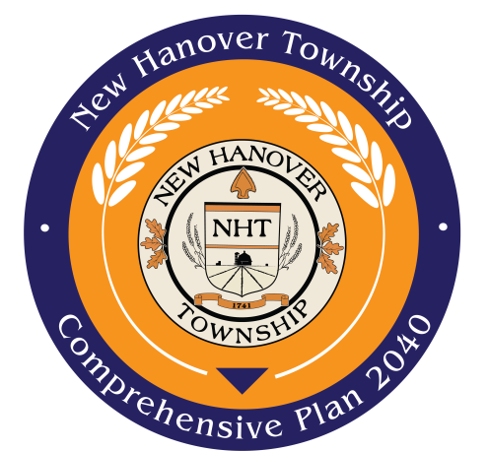
Tonight’s Agenda
Introductions
Group Session 1: Community Character
Group Session 2: Circulation
Group Session 4: Parks, Open Space, and Agriculture
Wrap-up
  Posters:
  Where Do You Live Map
  Vision Wall
Notes:
Before we dive into our discussion, let’s just quickly go over how the evening will work. Each session will be prefaced with a brief introduction to get your ideas flowing. We will spend 10 minutes within each group discussing the topic and you will have volunteers at your table taking notes to capture all your thoughts. At the end, we will spend a few minutes sharing some of the ideas your group came up with before moving on to the next topic.
Restrooms are located in the hallway and refreshments are in the room next door. If you didn’t get a chance before the meeting, we have some interactive maps for you to participate in which will be available after the meeting ends.
Let’s get started!

Slide 8
Community Character
Maps:
Zoning
Land Use
Preserve/Enhance/Transform
Photo collage

Slide 9
Community Character
Rural suburban landscape
  Primarily single family detached housing
Growing residential developments
  New townhouse and twin housing types
Limited commercial development
  Newer office and medical uses
  Well-established local restaurants/pubs

Slide 10
Group Discussion
What do you like/not like about the look, feel, and function of different community amenities and land uses?
What type of growth do you think is appropriate for the township? How are changes in development affecting you?
Do you feel the current business mix meets your needs? Do you want more retail opportunities in the township?
What do you want to preserve, enhance, or transform?

Slide 11
Circulation
Maps:
Roadways
Modes of Transportation
Photo collage

Slide 12
Circulation
The majority of roadways are locally owned, with limited primary routes linking residents to the wider vehicular transportation network.
Planned improvements include intersection upgrades and bridge replacements.
Limited pedestrian mobility between developments due to few connected sidewalks.
Limited to no on-road bike amenities.

Slide 13
Group Discussion
Where are your primary roadway concerns? Indicate locations on the map, and what the concern is.
Where would you like to see improved connections, either for vehicular, pedestrian, or bicycle access?
Where would you like sidewalks to go, if at all?
Where would you like to see trails, pathways, bike lanes, etc?

Slide 14
Parks, Open Space, and Ag
Maps:
Parks
Land Use
Photo collage

Slide 15
Parks, Open Space, and Agriculture
New Hanover has 13 parks and open space properties throughout the township. Amenities range from full playgrounds and recreation fields (active recreation) to walking trails and benches (passive recreation).
In addition to public open spaces, the township is also home to a number of golf courses.
Indoor recreation space is limited.
A number of farms are permanently preserved or are under other preservation statutes.

Slide 16
Group Discussion
What parks do you enjoy visiting? Why? What activities do you participate in there?
What other events and activities would you like to see at the parks? What other amenities would you like to see at the parks? Please indicate which activities at which parks, if applicable.
Do you feel there is an adequate number, size, location of parks throughout the township to meet your recreation needs? What is missing, if anything?
How important are parks to you in a rural township like New Hanover?
How important is agricultural preservation to you?

Slide 17
Next Steps
Follow the Comprehensive Planning Process online
  New Hanover Township Website
  https://www.newhanover-pa.org/departments/planning/comprehensive_plan.php
Future community events and additional opportunities for public feedback of the draft plan

Slide 18

Questions and Comments
Maggie Dobbs, AICP
610-292-4917
mdobbs@montcopa.org

